Slide 1
The New Government and Family Related Benefits in the UK
Jonathan Bradshaw
Open Seminar
Tackling Child Poverty: Lessons from the UK and New Frontiers in Japan
Doshisha University
Kyoto
January 9 2012

Slide 2
A bit of history
Until 1945 financial needs of children not recognised by the state – poor law, UAB, fostering or adoption
Eleanor Rathbone’s campaign for family allowances – motives:
  Poverty - Rowntree
  Gender equity – feckless men
  Pronatalism – eugenics movement

Slide 3
A bit more history
Family allowances opposed by Trade Unions who campaigned for a “family wage”
Adopted by Beveridge in 1942 report in order to ensure that UB could be paid at subsistence level w/o undermining work incentives
Enacted by Conservative Government (to hold wage demands down) but
  Only for second and subsequent child
  At lower rates than Beveridge proposed

Slide 4
Other elements in the post war child benefit package
Free school meals
Maternity grants
Welfare foods
Child additions in the benefit scales
Free health care
Child tax allowances
Character universality

Slide 5
Emerging problems
Family allowances too low
National assistance covering housing costs – no help for housing costs in work – wages trap led to Housing benefit and Council Tax benefit
Health charges and exemptions introduced
Character became means-tested
Meanwhile Child Tax Allowances
  costing the exchequer more than FA
  Of most value to higher rate tax payers
  No help to poorest non tax payers

Slide 6
“Rediscovery of Child Poverty”
Poor and the Poorest 1965
Circumstances of Children 1966
Child Poverty Action Group established 1968
1970 election “Poor worse off under Labour”
Tories win - Family Income Supplement introduced

Slide 7
Family Income Supplement
Income tested benefit
Working 24 plus hours
Based on five weeks pay slips
Paid to mother
Lasted six months regardless of income changes
Same threshold for lone parents and couples
Take up a problem and created a poverty trap
Became Family Credit - a means-tested in-work benefit until replaced in 1999 by WFTC

Slide 8
Child benefit
Introduced after bitter Cabinet battle between Barbara Castle and Dennis Healey exposed by “deep throat”.
Combines CTA and FA in one cash benefit
One parent benefit
Paid for every child, at a higher rate for the first child £20.30, £13.40 (April 2011)
To the mother transfer wallet to handbag.

Slide 9
Arguments over CB
Against
  Duchess of Westminster gets it (or did)
  Very expensive
  Could be better targeted – large families, young kids, taxed back, withdrawn
  Children private responsibility
  Encourages feckless breeding
  Misspent - vouchers better
For
  Maintains horizontal equity
  Children are a public good/human capital
  Why should parents carry the burden alone
  Encourages childbirth
  Benefit for women
  Contribution to work incentives
  Secure source of income at transition

Slide 10
Post 1979 (Thatcher)
Child benefit left to “wither on the vine”
Benefits for 16-18 year olds abolished
Income Support frozen
Surges in youth unemployment and children living in workless households
Family Credit replaces FIS –16 hours
One parent benefit and lone parent premium in Income Support abolished

Slide 11
Hike in poverty
Between 1979 and 1997 the relative child poverty rate in Britain increased 3 fold

Slide 12
Why do we worry about child poverty
Moral arguments – religious duty
Justice arguments – it is not fair, children not to blame
Poor investment – poor outcomes - waste of talent
Poverty associated with many social problems that harm us all
Costs a lot – losing 1% of GDP per year
Key indicator of government failure

Slide 13
Child poverty:1979-1995/6
60 per cent equivalent household income

Slide 14
Hike in poverty
Between 1979 and 1997 child poverty in Britain increased 3 times
Bigger increase than most industrial societies

Slide 15
Hike in poverty
Between 1979 and 1997 child poverty in Britain increased 3 times
Bigger increase than most industrial societies
In 1995 UK has the highest child poverty rate in the EU.

Slide 16
Child poverty rates 1995
60% of the national equivalised median income.
Euro-mean

Slide 17
Hike in child poverty
Between 1979 and 1997 child poverty in Britain increased 3 times
Bigger increase than most industrial societies
UK in 2001 has the fifth highest child poverty rate comparatively
Evidence suggests that this was driven by economics and demographics, but particularly by policy failure

Slide 18
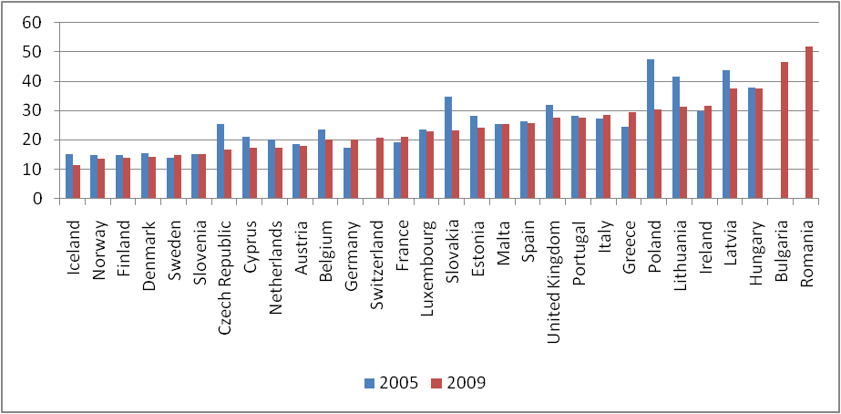
Child poverty rates in the EU (<60% median)

Slide 19
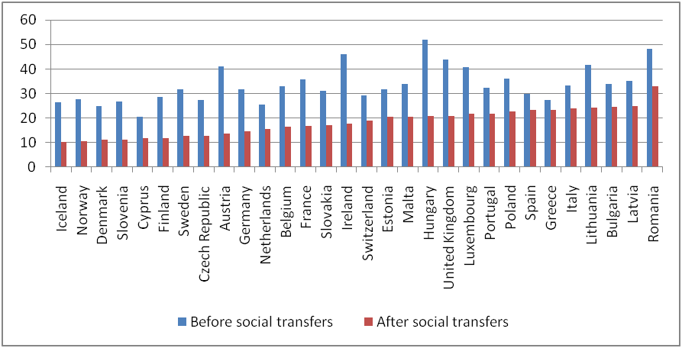
Still not making enough effort (2009 data)

Slide 20
End of child poverty
Prime Minister’s pledge:
“Our historic aim, that ours is the first generation to end child poverty forever….It’s a 20 year mission but I believe it can be done”

Slide 21
Results
(Before the recession) employment at record levels
Child poverty rate fell until 2004/5 – nearly met five year target
Child poverty gap reduced
UK one of only seven countries in OECD to have reduction in child poverty 1995-2005
UK moved up the international league table
All party consensus in Child Poverty Act – sensible targets and new commitment to develop a strategy
Here is some data

Slide 22
The child poverty strategy
Manage economy to ensure low inflation and high employment
Welfare to work
Increases in in-work benefits
Increases in out-of-work
Big invest in services - health, education childcare
Institutional transformation

Slide 23
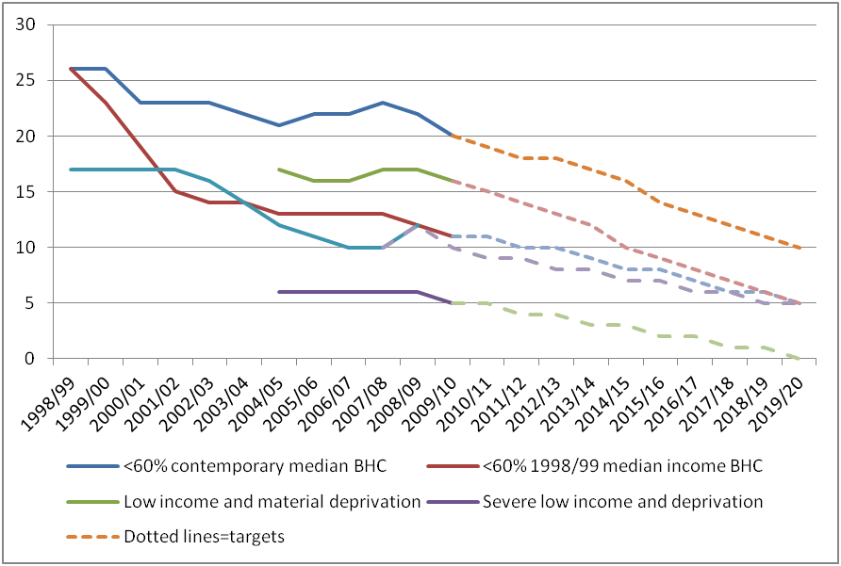
Child poverty fell – but not sustained

Slide 24
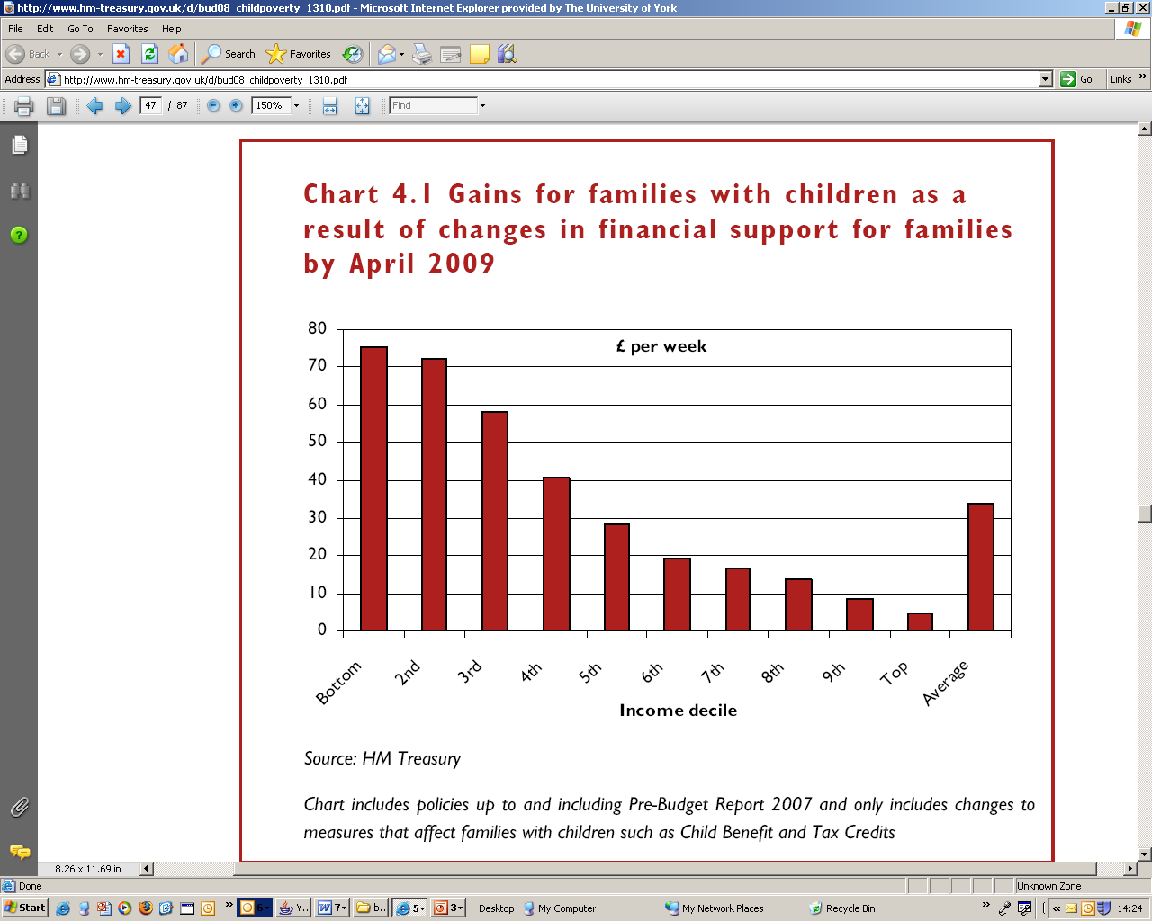

Slide 25
Public spending on family benefits in cash, services and tax measures
Percentage of GDP, in 2007.

Slide 26
Youth and youth transitions
Child benefit/Tax credit paid to parents until 19 if child in full-time education
Severe hardship payments in JSA IS.
No independent entitlement to unemployed youth until 19 then IS/JSA £51.85 per week until 24.
EMA for 16-18 £30 per week to young people plus bonuses payments of up to £500 for staying on. Now abolished

Slide 27
Conclusion on Labour years
Poverty was dire after the Tory years.
After a slow start much was being achieved.
Treatment right - dose inadequate

Slide 28
Net disposable income for a couple plus two children before housing costs by hours supplied at the minimum wage from April 2009. Rent = £60 a week, Council Tax = £18.00 a week

Slide 29
Child poverty targets for 2020
Relative low income = Equivalised net household income less than 60% median 2020 target: <10% of children
Combined low income and material deprivation = Material deprivation >20% and equivalised net household income less than 70% median 2020 target: <5% of children
‘Absolute’ low income= Equivalised net household income falling below 60% of the ‘adjusted base amount’ 2020 target: <5% of children
Persistent poverty= Equivalised net household income less than 60% of median for 3 years prior to current year 2020 target: not yet set

Slide 30
Now recession and new coalition government
Plan to cut £80 billion deficit by 2013
25% from increases in taxes
75% from cuts in services and huge reduction in public employment
Whole package highly regressive
Children have done much worse than pensioners
IFS say it will increase child poverty
Unemployment up – youth at record levels
Discourse has become behavioural
Focus on early years

Slide 31
Cuts in family benefits
Child benefits frozen for three years
To be taken back from higher rate tax payers after 2013
EMA abolished
Health in Pregnancy Grant and child trust funds abolished
Cuts in childcare tax credits 80% to 70% subsidy and Surestart maternity grant restricted to one child
Cuts in Child tax credits – reneges on promise for above inflation uprating
Uprate benefits by CPI rather than RPI
Increase VAT from 17.5% to 20%

Slide 32
Results
Relative child poverty will remain broadly constant between 2009/10 and 2012/13 at about 19% but will then rise to 24.4% by 2020.
Absolute child poverty will rise from 17% in 2009 to 23.2% in 2013 and then remain constant to 2020.
This unusual picture comes about because real median household income will be 7% lower in 2012/13 than it was in 2009/10 and remain below its 2009/10 level until 2015/16, due to high inflation and low earnings growth.

Slide 33
Other measures
UNIVERSAL CREDIT replacing all working age benefits in 2013. Good idea but
  Not universal
  Means-tested
  Leaves out passported benefits
  Reliant on massive IT
  Benefits cap
  Housing benefit room cap for tenants
Reassessment of Incapacity to work

Slide 34
Strategy not working
Unemployment rising - very high for youth
Growth effectively nil
Private jobs not replacing public jobs
Deficit targets not being met
EU crisis
Double dip recession

Slide 35
Conclusion
Role of state in supporting financial costs of children contested
Has been and still is mainly a private responsibility – increasingly for youth
Improvements have been made since 1999 – thanks to the child poverty agenda
Child Poverty Act high watermark
Now going backwards
But still much more effort than Japan?

